Slide 1
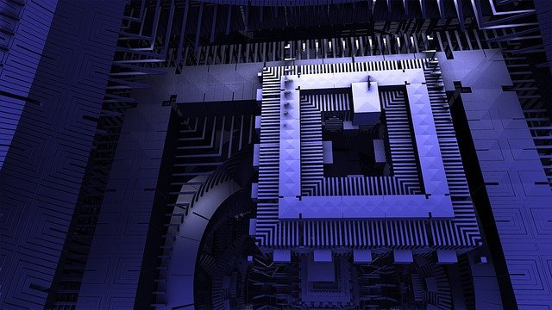
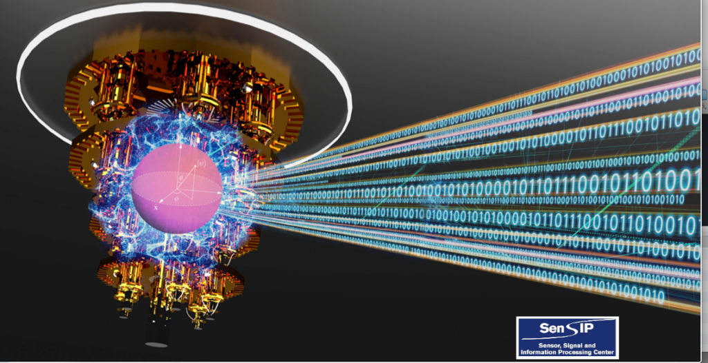
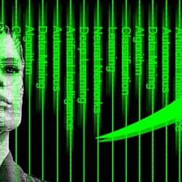
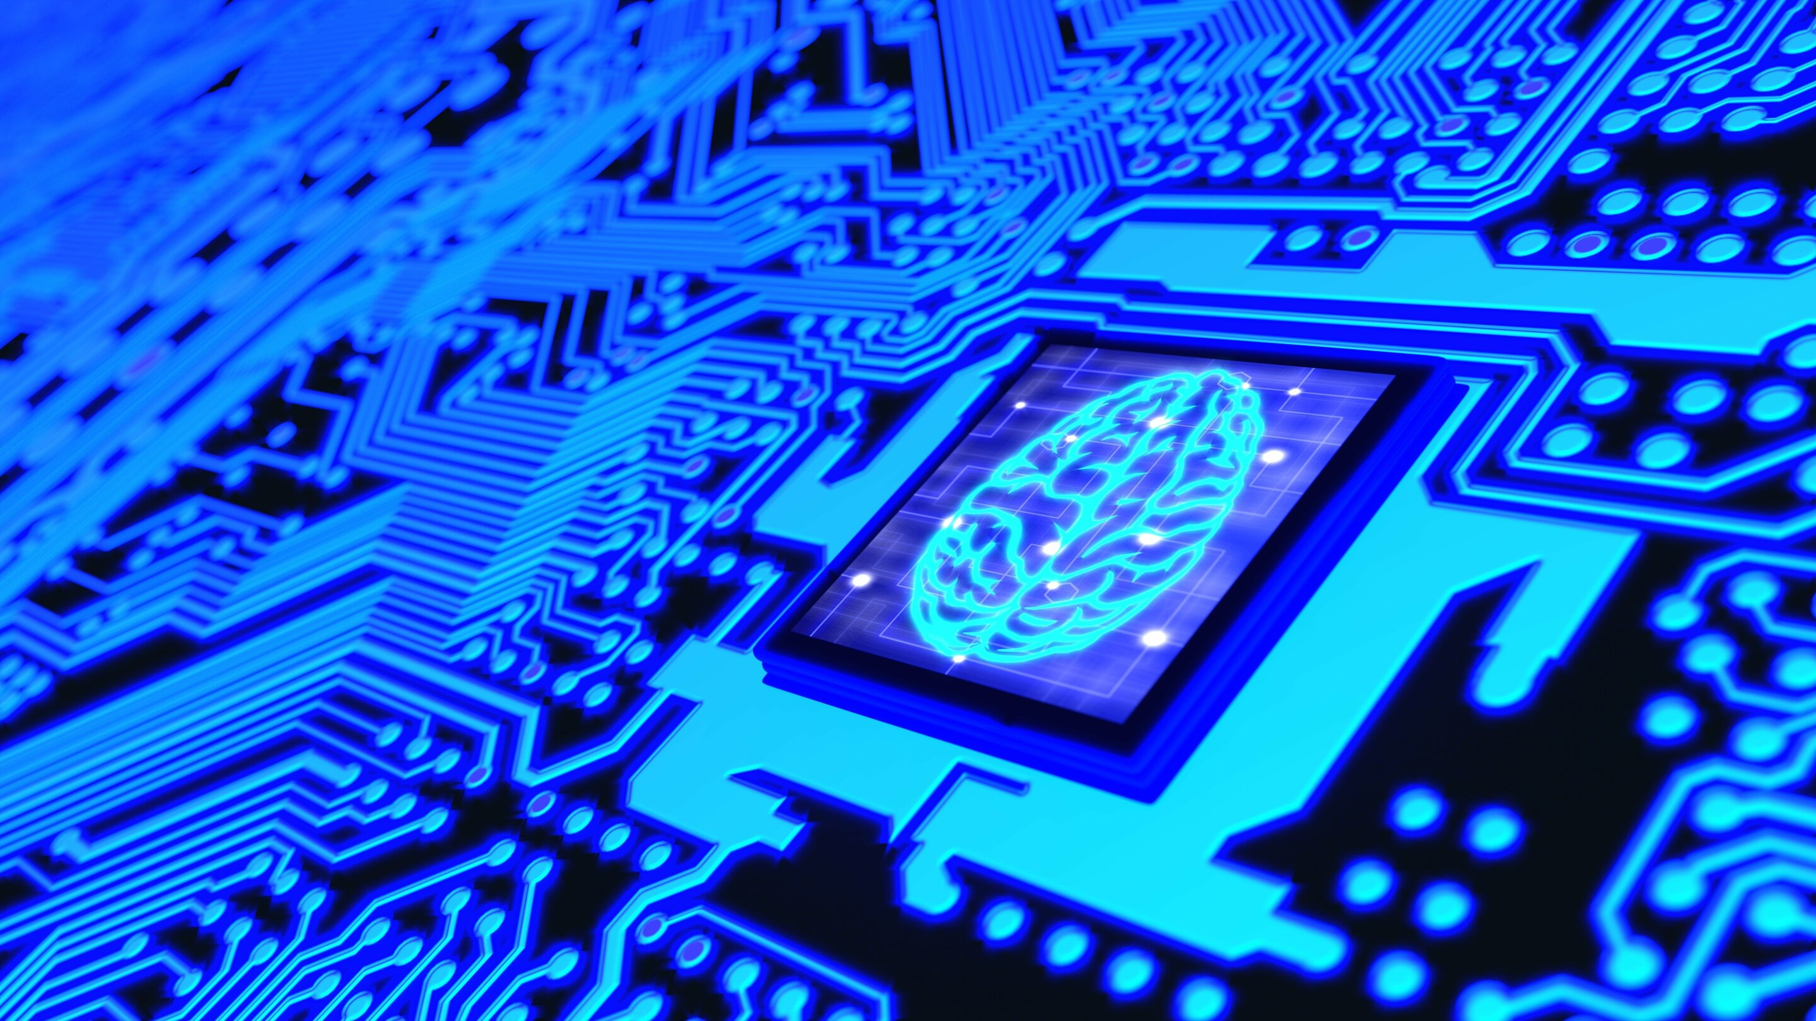
Quantum Machine Learning for Photovoltaic Topology Optimization

Slide 2
Agenda
Hybrid Quantum Neural Network for Topology Optimization
Preliminary Research
Comparison of approach
Next Steps

Slide 3
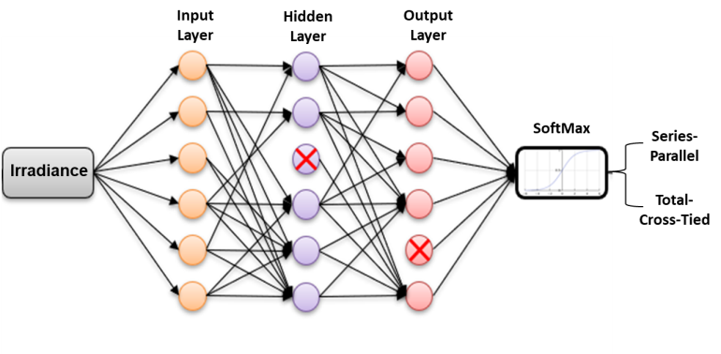
Classical Machine Learning for Topology Optimization
Introduction
It was shown that PV topology reconfiguration is a viable method for improving the power output under shaded conditions [1]
Various methods of reconnecting the panels have been proposed in [1], [2] to maximize the Photovoltaic (PV) array output
ML models, in particular, neural networks (NN) learn different patterns of the PV panel irradiances and predict the optimum configuration.
ML for this application produces an end-to-end system that learns a function to directly map irradiances to the optimal topology.
Notes:
At a high level, topology reconfiguration involves switching the electrical connections between the panels based on input control signals.
Various methods of reconnecting the panels have been proposed in [1], [2] to maximize the PV array output.
In general, PV arrays are connected in the series-parallel (SP) topology consisting of strings of panels connected in parallel.
Additionally, it has been shown in [2] that significant power improvements can be obtained when the array is connected in a cross-tied manner, for e.g., TCT array.
In the TCT topology every row consists of PV modules connected in parallel, and the resultant rows are connected in series.
These two topologies behave identically under perfect irradiance conditions.
However, when there are mismatches and partial shading, one of the topologies can outperform the other in terms of power production.
This naturally motivates the use of a ‘smart’ algorithm that automatically reconfigures the array into one of the topologies based upon the extent of shading or panel level irradiances.

Slide 4
Hybrid QNN for Topology reconfiguration
Introducing our system
In our previous work [17], a hybrid Quantum Neural Network (QNN) was designed for PV fault detection.
The hybrid QNN [18] system was designed and modeled using a state vector simulation [19].
The results of our previous studies yielded an accuracy of about 90%, which was very encouraging.
Motivated by previous results, we launched a study of topology optimization.
Notes:
TABLE 1. PREVIOUS FAULT DETECTION RESULTS AND COMPARISONS [17]
Fault Detection Algorithm Training Epoch Detection Accuracy
Classical NN 300 95.39%
Hybrid QNN1 (2 qubits) 25 87.8%
Hybrid QNN1 (2 qubits), 100 93.89%
Hybrid QNN1 (4 qubits), 25 90.2%
Hybrid QNN2 (2 qubits) 18 90.5%

Slide 5
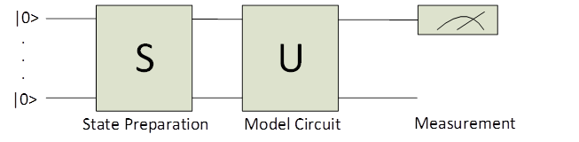
How we built our Quantum System
Hybrid Quantum Neural Network
To expand our quantum computing skills, we extended our Software Development Kit (SDK) to use Pennylane from Xanadu.
We proposed model based on circuit-centric classification [20] for designing a hybrid QNN
0: ──RX(1.00)──Rot(0.24,0.89,0.08)─╭C───────╭X─┤ <Z>
1: ──RX(2.00)──Rot(0.28,0.22,0.73)─╰X─╭C────│──┤ <Z>
2: ──RX(3.00)──Rot(0.83,0.29,0.63)────╰X─╭C─│──┤ <Z>
3: ──RX(4.00)──Rot(0.31,0.93,0.44)───────╰X─╰C─┤ <Z>
Notes:
First, the system prepares the data by performing a state preparation (S) by organizing the classical data into qubits to run the quantum circuit.
Next, the qubits are processed through a model circuit, relying on a basic Unitary transform (U).
Finally, qubit measurements are taken and transformed to binary data.
The circuit example prepares the input data into four qubits by angle embedding of the classical data.
A unitary transform of the circuit is used and this consists of a rotation gate (Rot) with each qubits being entangled.
We define Rot, Eq. (1), as an arbitrary single-qubit rotation where the weights are those used when training our system.
$$R\left(φ,θ,ω\right)=RZ\left(ω\right)RY\left(θ\right)RZ\left(φ\right)=$$
$\left[\begin{matrix}e^{−j{(φ+ω)}/2}cos(θ/2) & −e^{−j{(φ−ω)}/2}sin(θ/2) \\ e^{−j{(φ−ω)}/2}sin(θ/2) & e^{j{(φ+ω)}/2}cos(θ/2)\end{matrix}\right]$ (1)

Slide 6
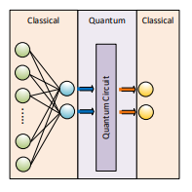
Hybrid Quantum Neural Network Example
We begin with a classical network
Here we build the quantum circuit as a hidden layer
We use the classical system as input and output to help prepare and present the data

Slide 7
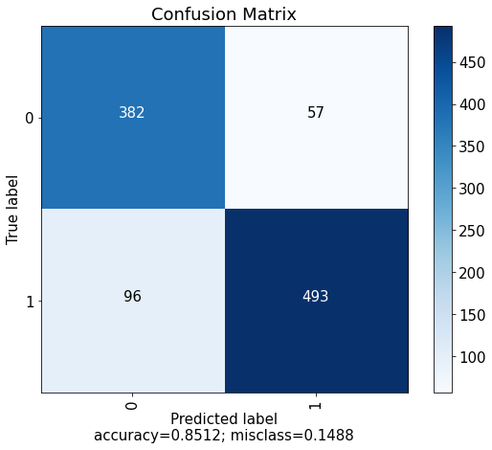
Hybrid QNN Confusion Matrix
Classical Neural Network
In our simulations, we tested both 2 qubits and 4 qubit circuits.
We observe here in the confusion matrix a 4-qubit with 1 layer results.
The quantum NN is evaluated as shown is found to have an accuracy of 85.12%.

Slide 8
Topology Optimization results
Comparing our Results
Here we present our testing results
We ran our quantum circuit using quantum simulator
A quantum simulator is a mathematical model that runs on classical systems
We compared different layers and number of qubits vs our classical ML system
As we can see, the hybrid quantum neural network does show that it can process similar data
Type | Qubit | Layers | Neuron vs gates | Epoch | Accuracy
Classical | N/A | 3 | 150 | 150 | ~95%
Quantum | 2 | 1 | 6 | 30 | 69.26%
Quantum | 4 | 1 | 12 | 30 | 85.12%
Quantum | 2 | 4 | 18 | 30 | 76.56%
Quantum | 4 | 4 | 36 | 30 | 82.30%
Notes:
We that with our data, we do require 4 qubits. The features and mapping with 2 qubits does reduce the accuracy. Though we cannot reach the optimal 90+%, we may be able to gain additional improvements by looking at the quantum circuit design.

Slide 9
Our Next Steps
With the simulation time and complexity of the circuit, a single-layer circuit may be sufficient for this type of dataset for initial testing.
Further improvements to the four qubit, one-layer system will need further research.
Future research will address quantum noise models.
We observed that a QNN with only four qubits and one-layer gave promising results.
Although, the classical NN provided a test accuracy of approximately 95%, the hybrid QNN achieved 85%.
From sample simulation results and additional hyperparameter tuning it is anticipated that the QNN may achieve similar results.

Slide 10
Reference
[1] S. Rao, S. Katoch, V. Narayanaswamy, G. Muniraju, C. Tepedelenlioglu, A. Spanias, P. Turaga, R. Ayyanar, and D. Srinivasan, “Machine Learning for Solar Array Monitoring, Optimization, and Control,” Synth. Lect. Power Electron., vol. 7, no. 1, pp. 1–91, Morgan and Claypool Publishers, 2020.
[2] H. Braun, S. T. Buddha, V. Krishnan, A. Spanias, C. Tepedelenlioglu, T. Yeider, and T. Takehara, “Signal processing for fault detection in photovoltaic arrays,” in ICASSP, IEEE International Conference on Acoustics, Speech and Signal Processing - Proceedings, 2012, pp. 1681–1684.
[3] R. Fazai, K. Abodayeh, M. Mansouri, M. Trabelsi, H. Nounou, M. Nounou, and G. E. Georghiou, “Machine learning-based statistical testing hypothesis for fault detection in photovoltaic systems,” Sol. Energy, vol. 190, pp. 405–413, 2019.
[4] K. Jaskie, J. Martin, and A. Spanias, “PV Fault Detection Using Positive Unlabeled Learning,” Appl. Sci., vol. 11, no. 12, p. 5599, 2021.
[17] G. Uehara, S. Rao, M. Dobson, C. Tepedelenlioglu, and A. Spanias, “Quantum Neural Network Parameter Estimation for Photovoltaic Fault Detection,” 2021.
[18] Z. Jia, B. Yi, R. Zhai, Y. Wu, G. Guo, and G. Guo, “Quantum Neural Network States: A Brief Review of Methods and Applications,” Adv. Quantum Technol., vol. 2, no. 7–8, p. 1800077, 2019.
[20] M. Schuld, A. Bocharov, K. M. Svore, and N. Wiebe, “Circuit-centric quantum classifiers,” Phys. Rev. A, vol. 101, no. 3, p. 32308, 2020.

